Slide 1
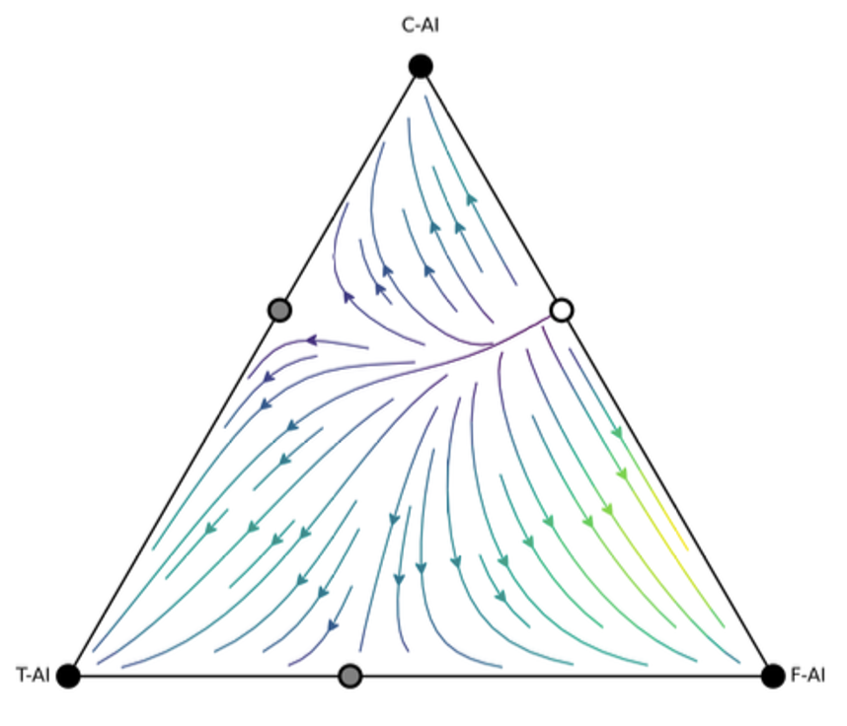
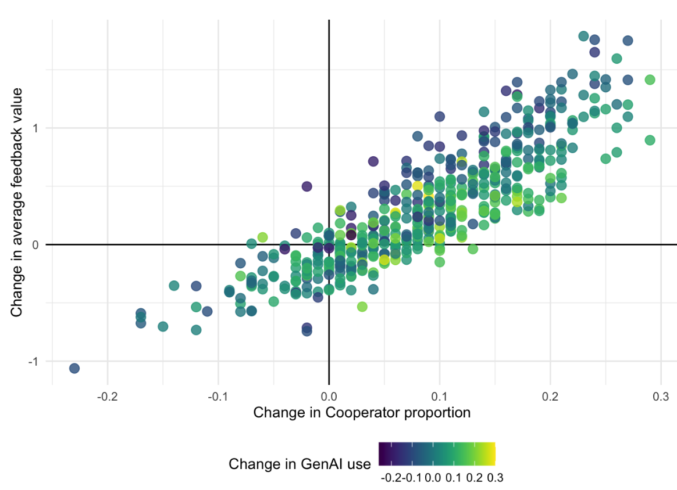


Game Theoretic Models of Intangible Learning Data
Ben Hicks (PhD candidate)
Kirsty Kitto
Connected Intelligence Centre
University of Technology Sydney

Slide 2



Some uncontroversial (?) statements
Learning Analytics is about Learning
Learning Analytics arose from studying available data
Learning Analytics (mostly) examines data we can observe
Notes:
Sometimes these aspects lead to conflict

Slide 3
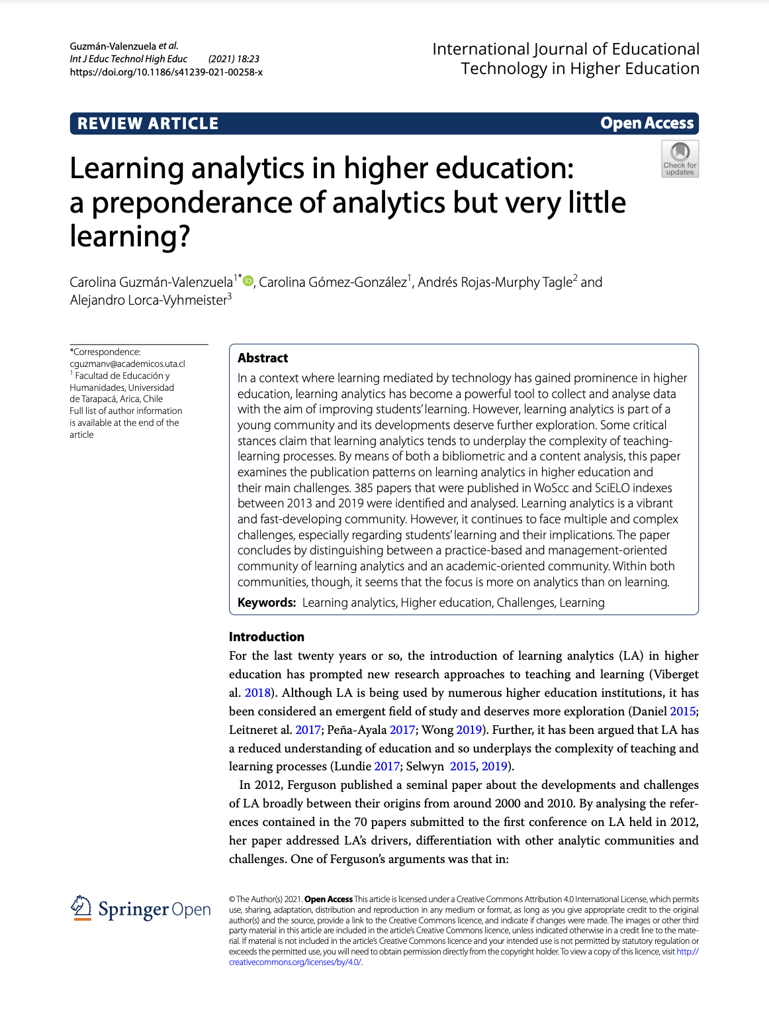
LA: More about analytics than about learning?
Guzmán-Valenzuela C, Gómez-González C, Rojas-Murphy Tagle A, Lorca-Vyhmeister A. Learning analytics in higher education: a preponderance of analytics but very little learning? Int J Educ Technol High Educ. 2021;18(1):23. doi: 10.1186/s41239-021-00258-x. Epub 2021 May 4. PMID: 34778523; PMCID: PMC8092999.

Slide 4
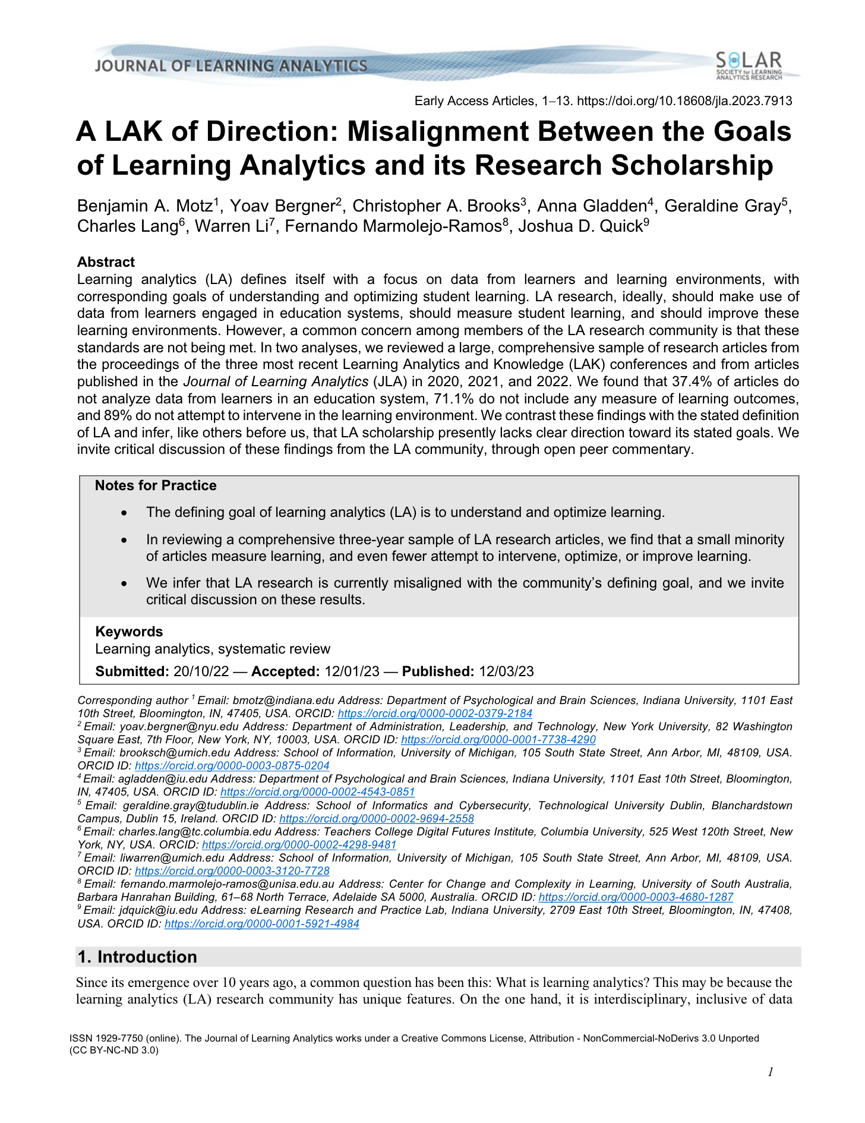
Misalignment between LA goals and research
Motz, B. A., Bergner, Y., Brooks, C. A., Gladden, A., Gray, G., Lang, C., Li, W., Marmolejo-Ramos, F., & Quick, J. D. (2023). A LAK of Direction: Misalignment Between the Goals of Learning Analytics and its Research Scholarship. Journal of Learning Analytics, 10(2), 1-13. https://doi.org/10.18608/jla.2023.7913

Slide 5
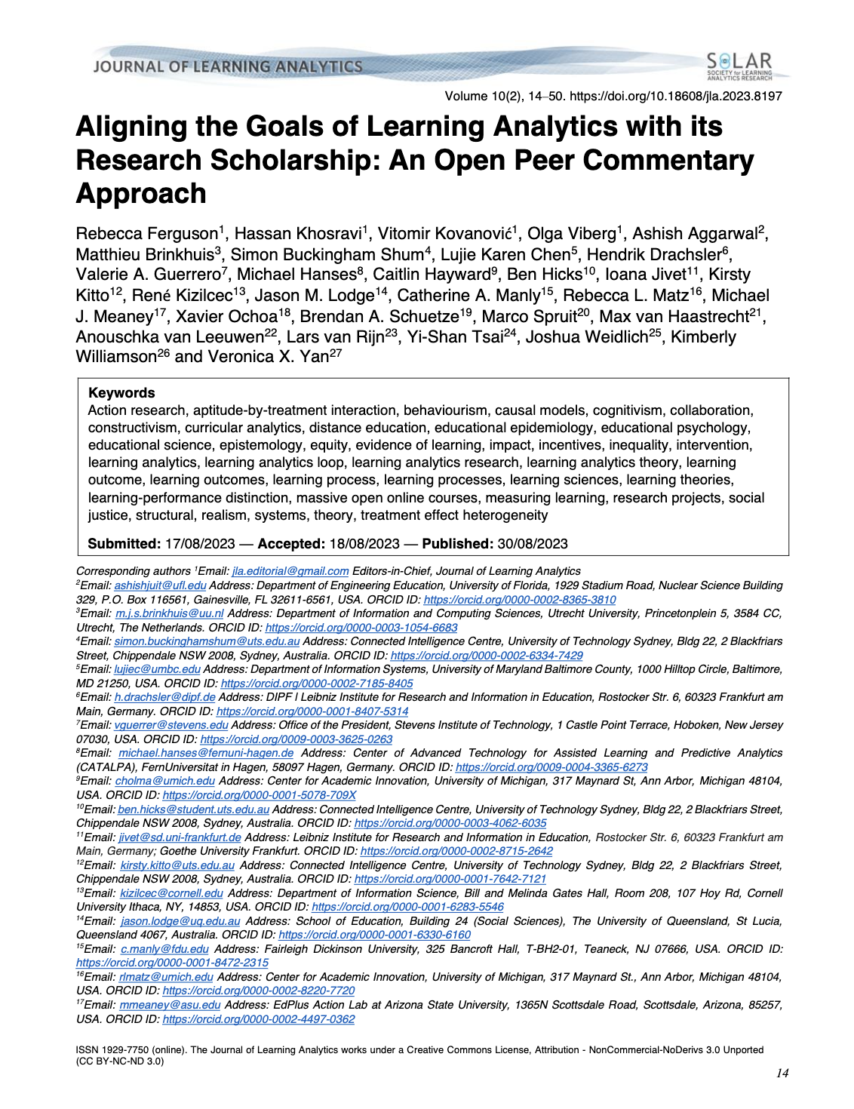
Learning outcomes and learning often conflated
Ferguson, R. ., Khosravi, H., Kovanović, V., Viberg, O., Aggarwal, A., Brinkhuis, M., Buckingham Shum, S., Chen, L. K., Drachsler, H., Guerrero, V. A., Hanses, M., Hayward, C., Hicks, B., Jivet, I., Kitto, K., Kizilcec, R., Lodge, J. M., Manly, C. A., Matz, R. L., Meaney, M. J., Ochoa, X., Schuetze, B. A., Spruit, M., van Haastrecht, M., van Leeuwen, A., van Rijn, L., Tsai, Y.-S., Weidlich, J., Williamson, K., & Yan, V. X. (2023). Aligning the Goals of Learning Analytics with its Research Scholarship: An Open Peer Commentary Approach. Journal of Learning Analytics, 10(2), 14-50. https://doi.org/10.18608/jla.2023.8197

Slide 6
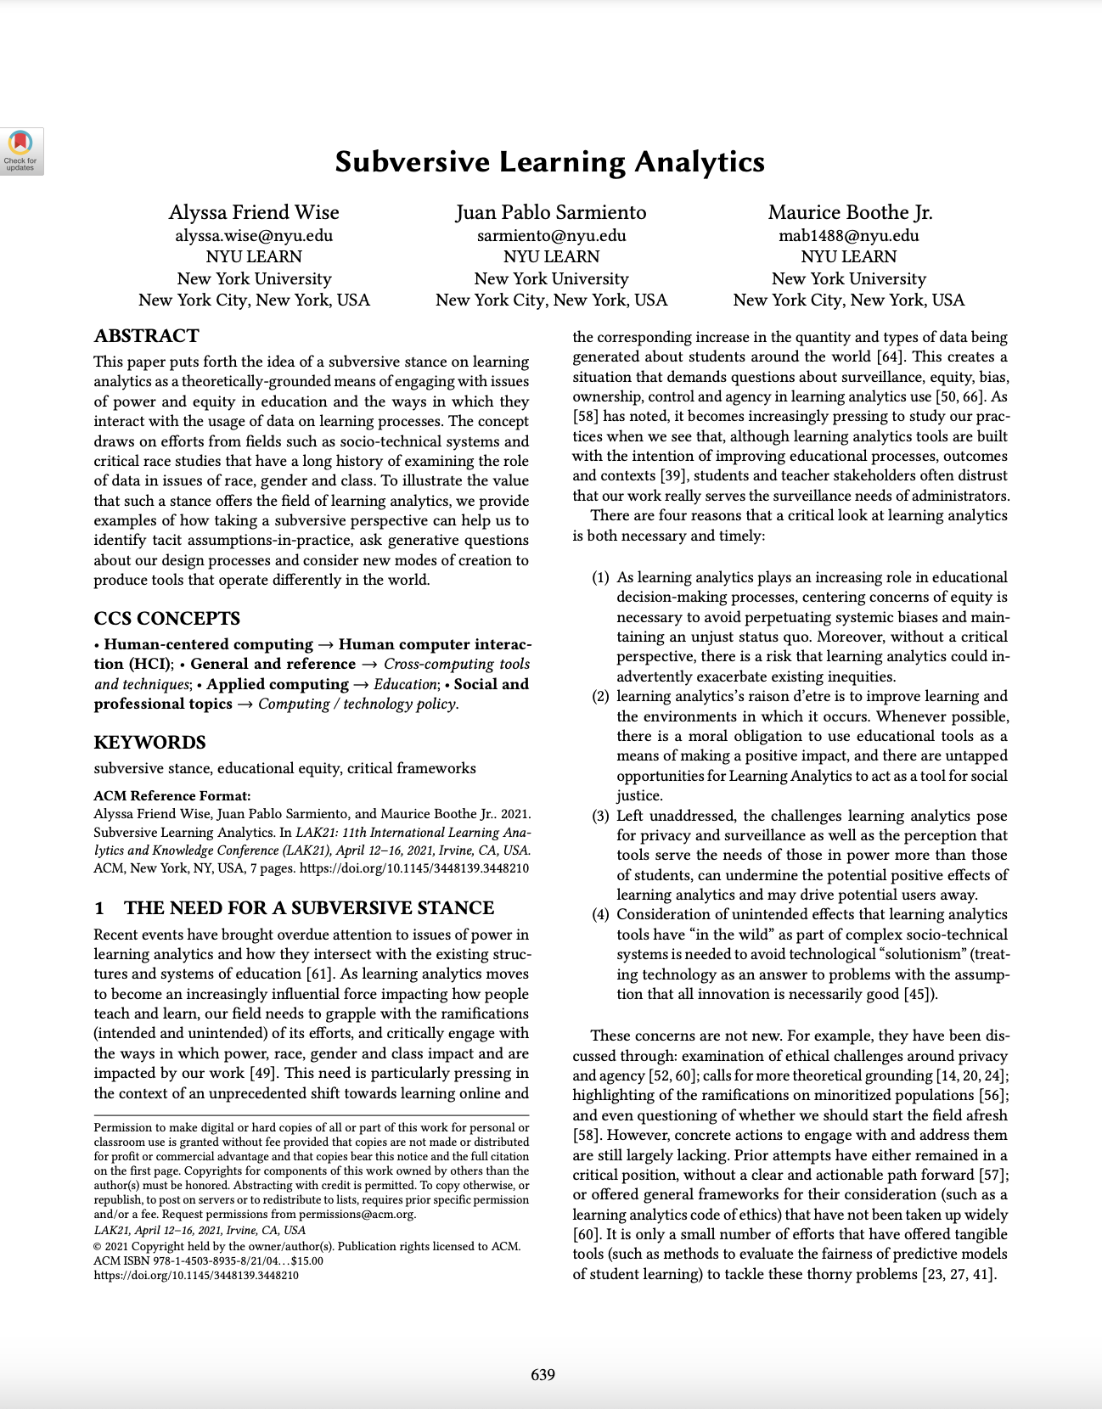
Missing data important to learning should be acknowledged
Alyssa Friend Wise, Juan Pablo Sarmiento, and Maurice Boothe Jr. 2021. Subversive Learning Analytics. In LAK21: 11th International Learning Analytics and Knowledge Conference (LAK21). Association for Computing Machinery, New York, NY, USA, 639–645. https://doi-org.ezproxy.lib.uts.edu.au/10.1145/3448139.3448210

Slide 7
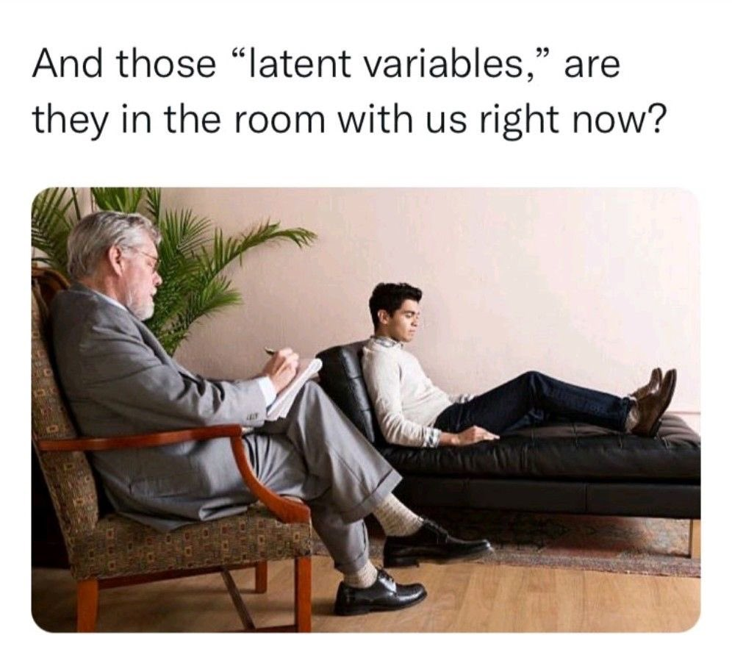
Methods for addressing missing data
Imputation – fill in missing examples from existing observations of the same thing
Modelling latent variables – build constructs from observations of a related thing

Slide 8
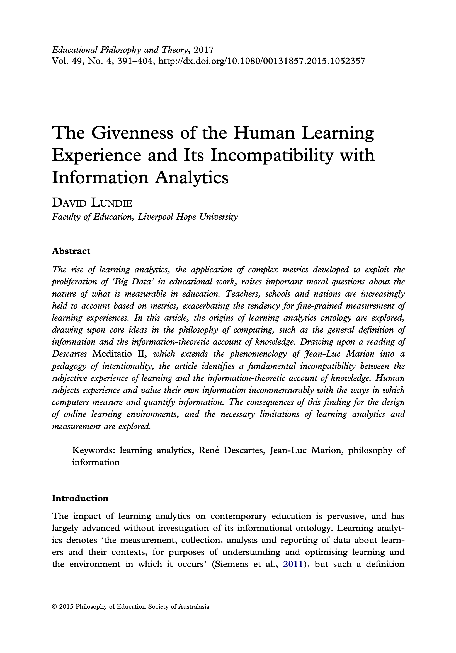
Learning is more than we can measure
What if there are things important to learning that are (currently) “intangible”?
Lundie, D. (2015). The Givenness of the Human Learning Experience and Its Incompatibility with Information Analytics. Educational Philosophy and Theory, 49(4), 391–404. https://doi-org.ezproxy.lib.uts.edu.au/10.1080/00131857.2015.1052357

Slide 9
A proposal for addressing intangible data
This paper explores a way to approach intangible aspects of learning, and how it might be linked to existing data, using Evolutionary Game Theory and simulation.

Slide 10
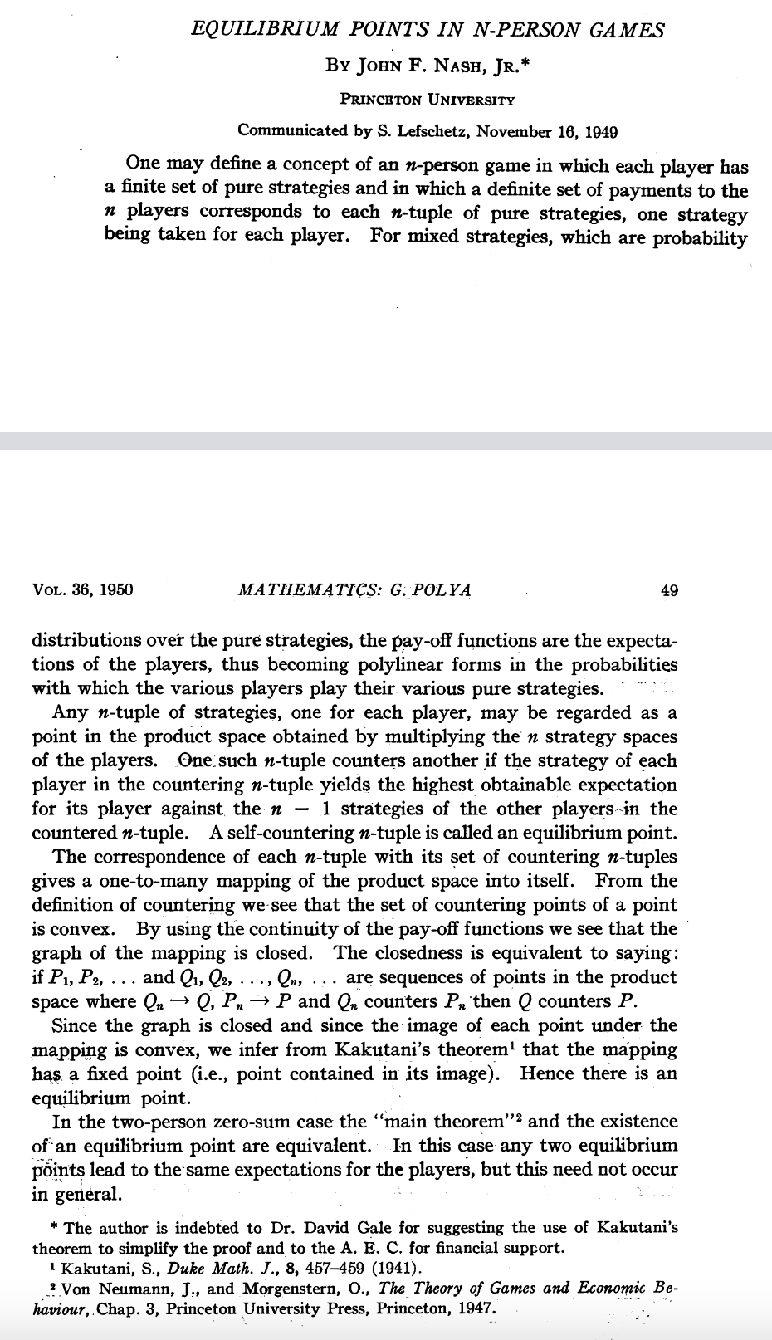
Game Theory
Mathematical analysis of games – what kind of strategies help players “win”.
Used to studying decision making under various scenarios (i.e. a hidden cognitive process).
Adopted mostly by economics.
& J.F. Nash, Equilibrium points in n-person games, Proc. Natl. Acad. Sci. U.S.A. 36 (1) 48-49, https://doi.org/10.1073/pnas.36.1.48 (1950).

Slide 11
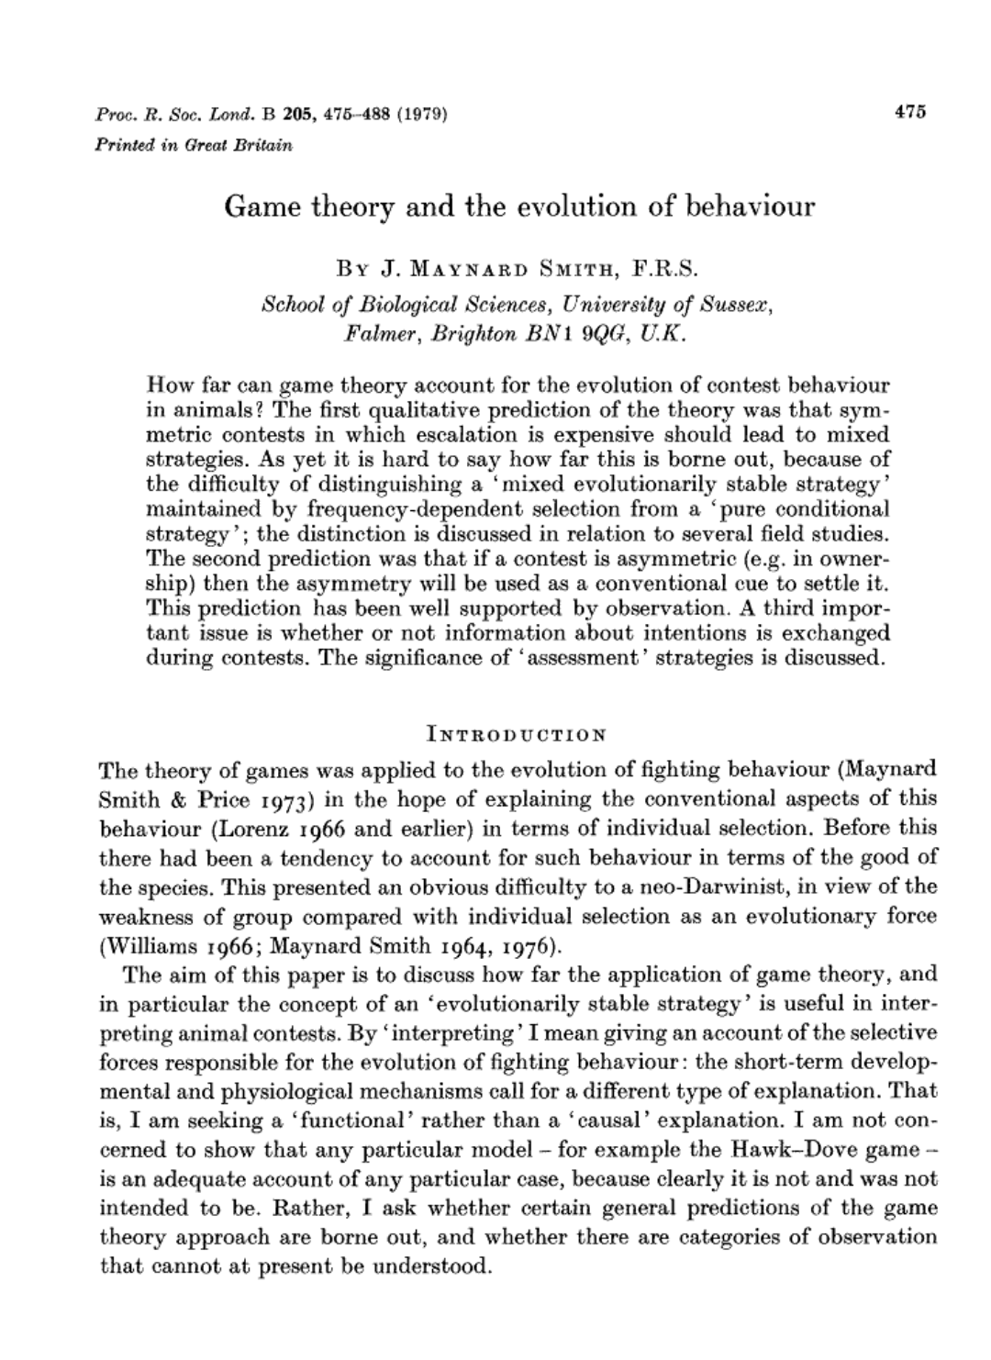
Evolutionary Game Theory
Studies strategies evolving over time. Hidden processes of numerous agents, over time.
Used as an improvement on Darwin’s theory of evolution.
Smith, J. M. (1979). Game theory and the evolution of behaviour. Proceedings of the Royal Society of London. Series B. Biological Sciences, 205(1161), 475-488.

Slide 12
System Dynamics > Location
Working with Evolutionary Game Theory models requires a different frame of reference.
Notes:
NEED META slide here about derscribing what we can at the right scale (between humans), running the simulation, linking the appropriate aggregation to what we can observe

Slide 13








RQ: How can game theoretic models connect intangible data to the data that we have available in LA?
Describe what we can
Describe this formally in mathematics (in this case, the Game)
Simulate interactions to explore environments (the game evolves)
Collect system changes over a range of environments

Slide 14
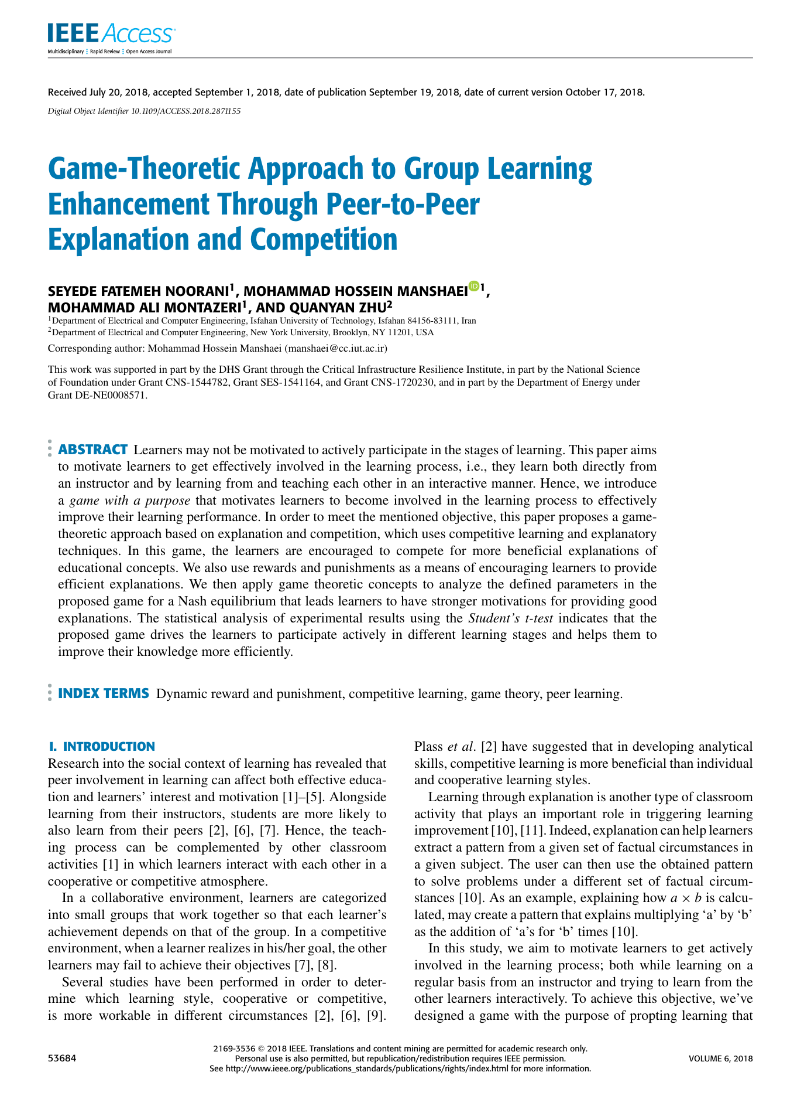
Modelling case study: Peer feedback
Learners are paired to give each other feedback on a piece of work.
This requires effort but also gives some benefits.
There is a tension between cooperative and “free-riding” behaviour.
Observing “effort” is extremely difficult.
S. F. Noorani, M. H. Manshaei, M. A. Montazeri and Q. Zhu, "Game-Theoretic Approach to Group Learning Enhancement Through Peer-to-Peer Explanation and Competition," in IEEE Access, vol. 6, pp. 53684-53697, 2018, doi: 10.1109/ACCESS.2018.2871155.
Notes:
Observation: Being honest with yourself about your own effort is hard enough.

Slide 15



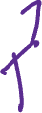




The Game

Slide 16









The Game
Students review each other’s work, and decide how much effort to put in.

Slide 17


The Game
They share this feedback with each other.

Slide 18




The Game
They incur some cost from completing the feedback, depending on how much effort they put in. This is their strategy.
The paper explores three strategies initially:
Cooperator, applying maximum effort.
Token-effort, applying half effort.
Free-rider, applying negligible effort.

Slide 19


The Game
They get some perceived value from the feedback (dependent on how much effort their fellow student put in)

Slide 20


The Game
They get some perceived value from the completing the feedback (depending on how much effort they put in).

Slide 21
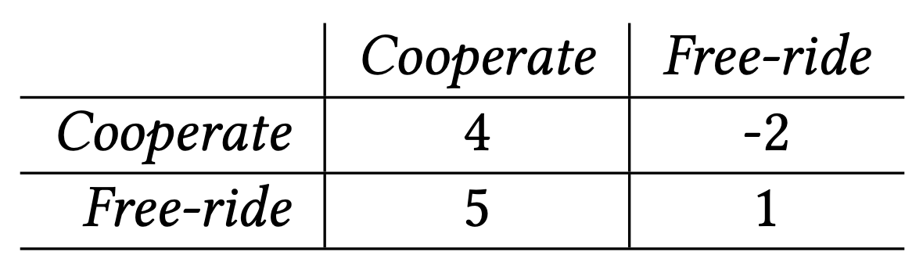









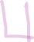

The Game
This “payoff” between strategies can be summarized in a payoff matrix
Notes:
Remember: the frame of reference!!

Slide 22














The Game Evolves
We analyse lots of these interactions

Slide 23
Strategy evolution
We display the distribution of Cooperators, Token-effort, and Free-rider strategies:
Cooperator
Token-effort
Free-rider
Notes:
What strategy do students choose?

Slide 24
Strategy evolution
We display the distribution of Cooperator, Token-effort, and Free-rider strategies:
Cooperator
Token-effort
Free-rider

Slide 25
Strategy evolution
As students change strategy, the distribution moves:
Cooperator
Token-effort
Free-rider

Slide 26
Strategy evolution
As students change strategy, the distribution moves:
Cooperator
Token-effort
Free-rider

Slide 27
Strategy evolution
The system dynamics are our reference frame
Cooperator
Token-effort
Free-rider
Notes:
What have we discarded? Location / amount of students. We are interested in movement

Slide 28
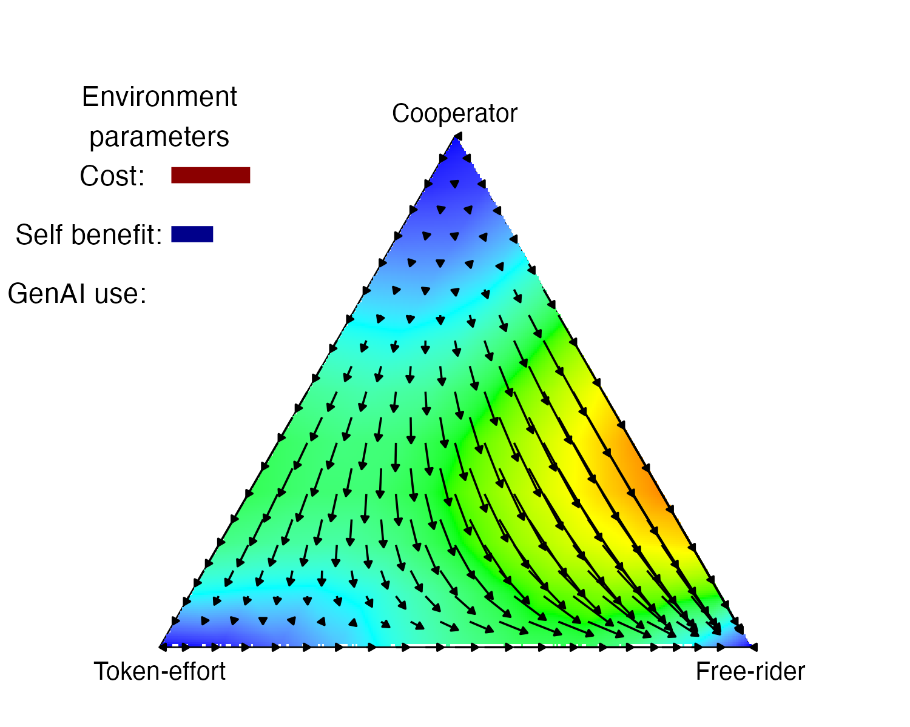

Strategy evolution
Under what conditions do we promote / impede cooperation?
Unstable:
Most change strategy
Stable:
Most keep strategy

Slide 29
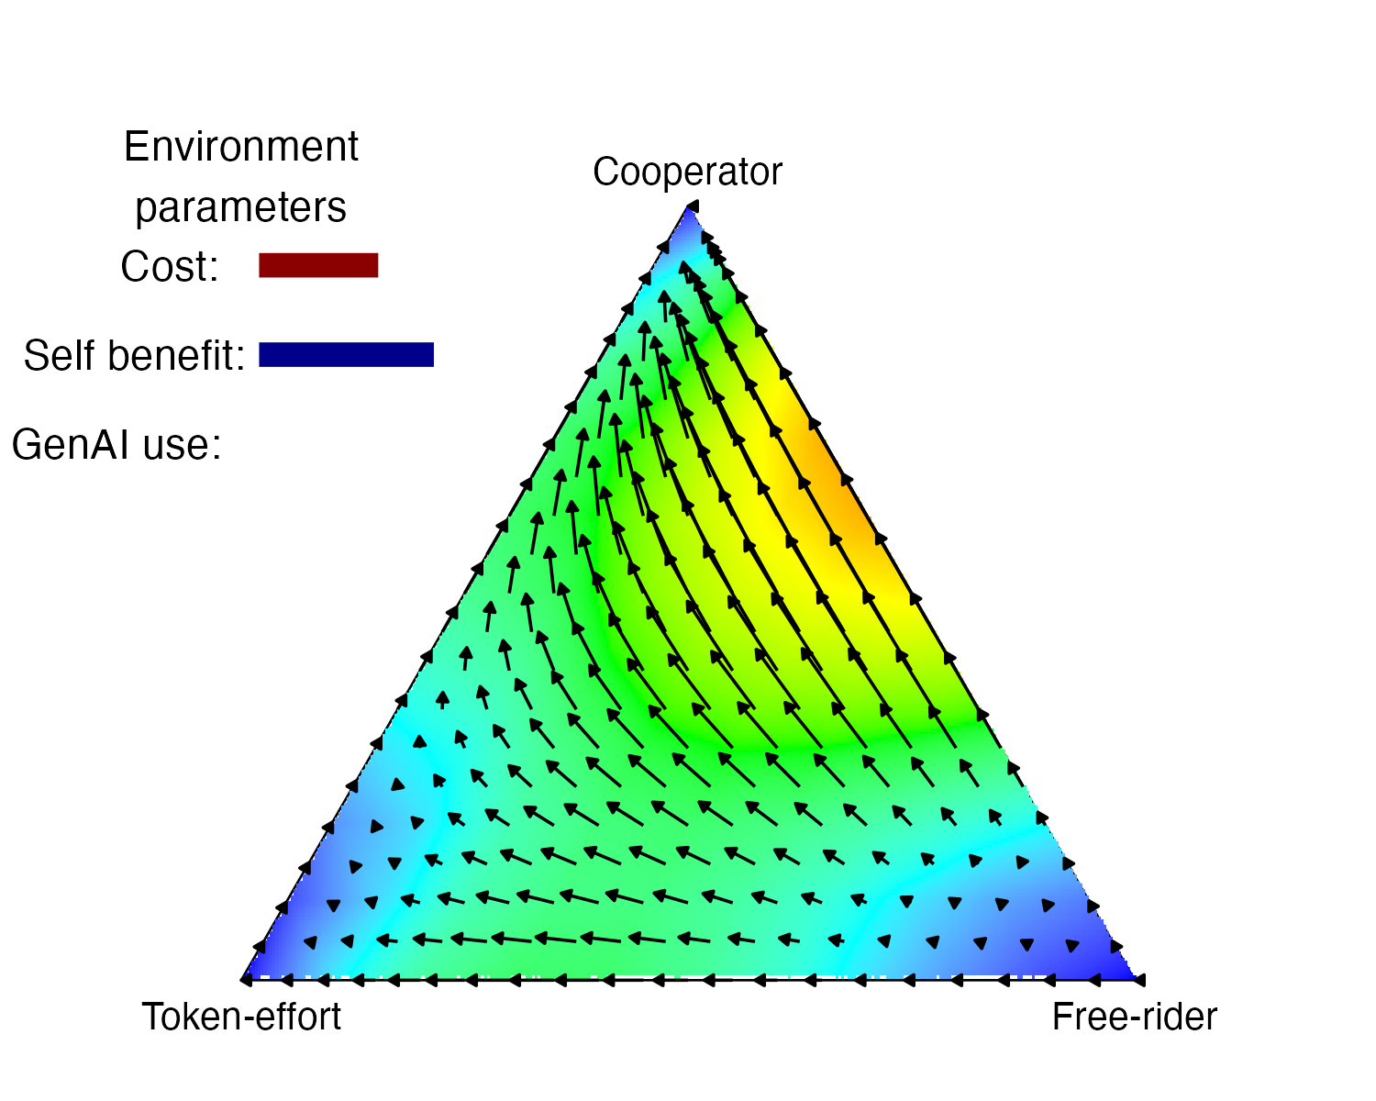
Strategy evolution
Under what conditions do we promote / impede cooperation?
Unstable:
Most change strategy
Stable:
Most keep strategy

Slide 30

LLMs Invade!
Extra strategy choice:
How much to use genAI to support providing feedback?
An increase in genAI use will:
Lower the cost of providing feedback
Lower the self-benefit of providing feedback
Change the value of the feedback (depending on genAI quality)

Slide 31
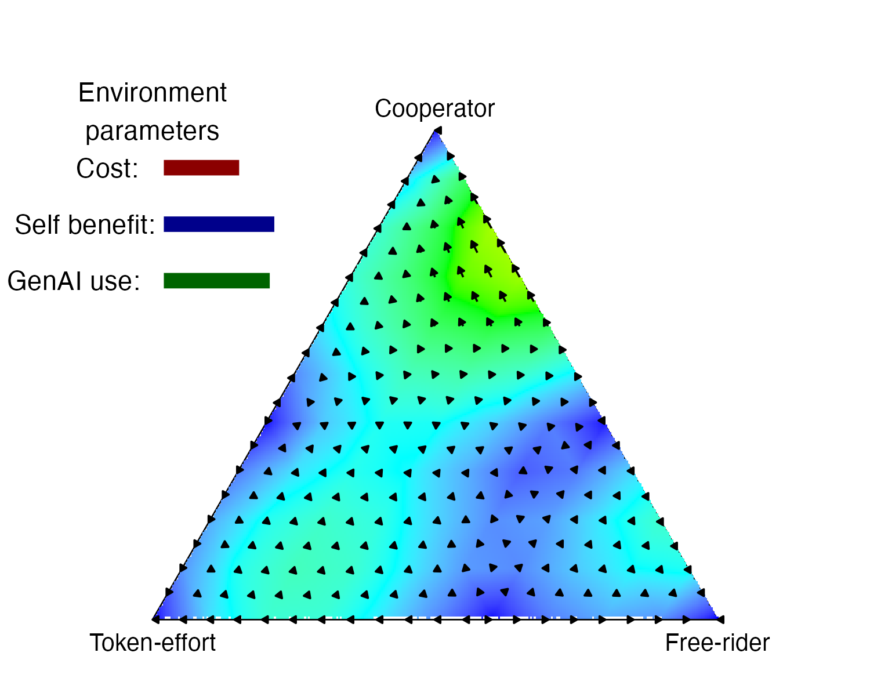
Strategy evolution
Under what conditions do we promote / impede cooperation?
Unstable:
Most change strategy
Stable:
Most keep strategy

Slide 32
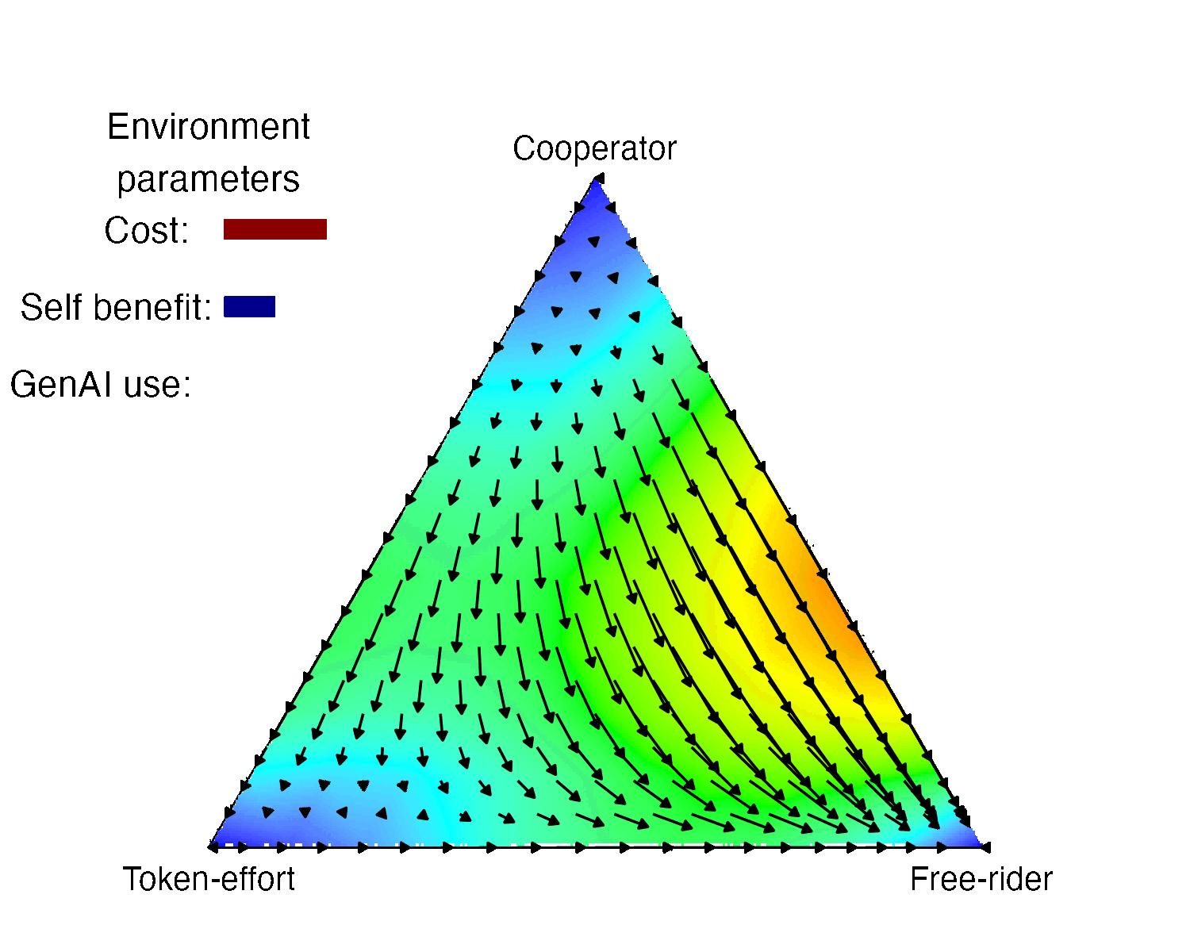
Strategy evolution
Under what conditions do we promote / impede cooperation?
Unstable:
Most change strategy
Stable:
Most keep strategy
Notes:
Describe dampening. SLOWLY.
This is all very fun, but…

Slide 33
Data generation of what we might observe
Simulating:
Change …
Notes:
CHANGE is what we might observe (if not measure)

Slide 34
Data generation of what we might observe
Simulating:
Change in cooperation

Slide 35
Data generation of what we might observe
Simulating:
Change in cooperation
Change in learning impact of cooperation

Slide 36
Data generation of what we might observe
Simulating:
Change in cooperation
Change in learning impact of cooperation
Change in use of GenAI

Slide 37
Data generation of what we might observe
Simulating:
Change in cooperation
Change in learning impact of cooperation
Change in use of GenAI

Slide 38
What have we done?
Described a learning situation with no data…
…mathematically
Used this to model a range of scenarios
Collected this results to form a simulated data distribution
We’re not making claims about the future of cooperation and GenAI – but this proof of concept is a way we might see into the unknown.

Slide 39
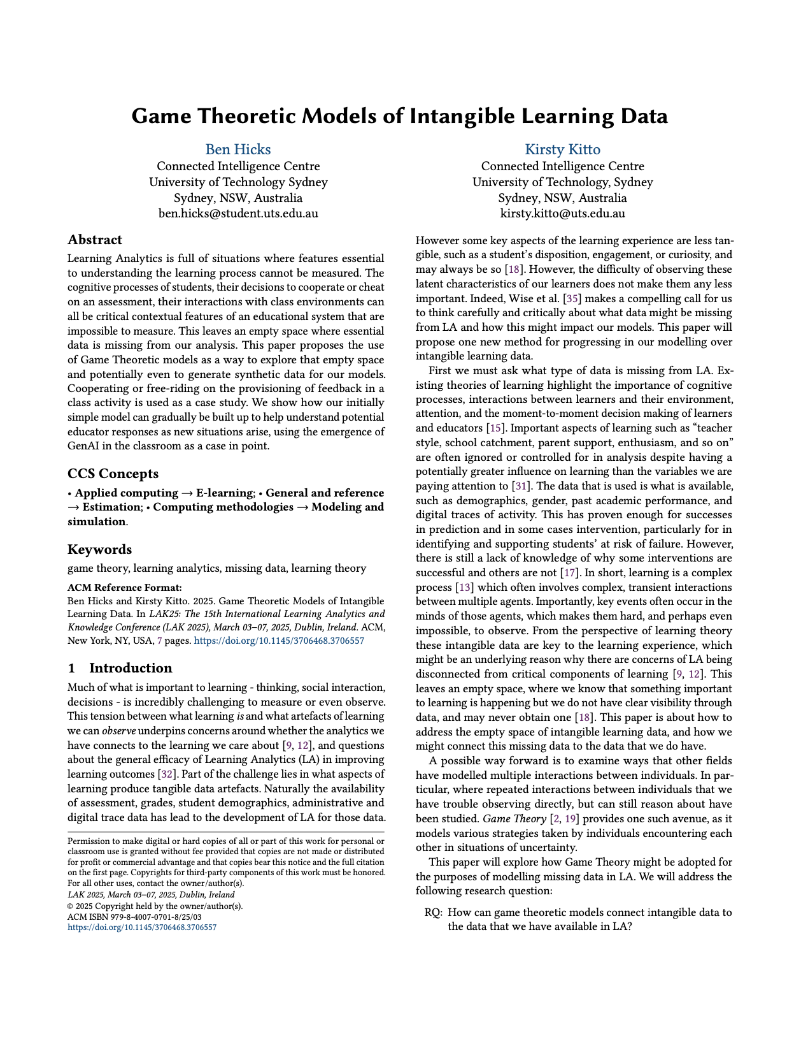


Paper:
Code:

Slide 40
You’ve gone to far Ben, go back
Unless people want more maths…

Slide 41

What’s in it for me? (I’m $R_{j}$)
The value I perceive to get from receiving (R) feedback when person i provides (P) me feedback.

Slide 42
What’s in it for me? (I’m $R_{j}$)
I get some value from the feedback (f) based on how much effort (Theta) Pi puts in (Theta_P_i)

Slide 43
What’s in it for me? (I’m $R_{j}$)
Depending on how much effort I put in (Theta_R_j) I get some benefit (b) but also incur a cost (c).

Slide 44
What’s in it for me? (I’m $R_{j}$)
I also perceive some social benefit from working with people who put in a similar amount of effort.

Slide 45
How much effort should I put in? This is my strategy.
$$V\left(R_{j} | P_{i}\right)={Θ_{P}}_{i}f+(1−|{Θ_{P}}_{i}−{Θ_{R}}_{j}|)a$$
$$V\left(R_{j} | P_{i}\right)={Θ_{P}}_{i}f+b−c+(1−|{Θ_{P}}_{i}−{Θ_{R}}_{j}|)a$$

Slide 46
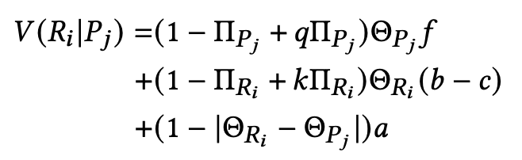
Adding GenAI

Slide 47
Adding GenAI, with quality q and cost reduction k
Old model
Introducing GenAI

